Slide 1
Deadlocks
Chapter 6
3.1. Resource
3.2. Introduction to deadlocks
3.3. The ostrich algorithm
3.4. Deadlock detection and recovery
3.5. Deadlock avoidance
3.6. Deadlock prevention

Slide 2
Resource (1)
A resource is a commodity needed by a process.
  printers
  Disk
  CPU time
Resources can be either:
  serially reusable: e.g., CPU, memory, disk space, I/O devices, files.
  acquire → use → release
  consumable: produced by a process, needed by a process; e.g., messages, buffers of information, interrupts.
  create → acquire → use
  Resource ceases to exist after it has been used, so it is not released.
Notes:
Courtesy by: Cornell University and UIUC

Slide 3
Resource (2)
Resources can be either:
  shared among several processes or
  dedicated exclusively to a single process.

Slide 4
Resource (3)
Resources can also be either:
  preemptable: can be taken away from a process with no ill effects
  e.g., CPU, Memory
  non-preemptable: will cause the process to fail if taken away
  e.g., CD recorder, Printer.
Generally Deadlocks involve exclusive access to non-preemptable resources.

Slide 5
Resources (4)
Sequence of events required to use a resource
  request the resource
  use the resource
  release the resource
If requested resource is not available the requesting process is blocked

Slide 6
Introduction to Deadlocks
Formal definition :
A set of processes is deadlocked if each process in the set is waiting for an event that only another process in the set can cause
Usually the event is release of a currently held resource
  This kind of deadlock is called Resource Deadlock

Slide 7
Introduction to Deadlocks
None of the deadlocked processes can …
  run
  release resources
  be awakened
A real life example
  Kansas 20th century law:
  “When two trains approach each other at a crossing,
  both shall come to a full stop and neither shall start up again until the other has gone”

Slide 8
Four Conditions for Deadlock
Mutual exclusion condition
  each resource is assigned to exactly 1 process or is available
Hold and wait condition
  process holding resources can request additional resources
No preemption condition
  previously granted resources cannot be forcibly taken away
Circular wait condition
  must be a circular chain of 2 or more processes
  each is waiting for resource held by next member of the chain
    T₁ is waiting for a resource that is held by T₂
    T₂ is waiting for a resource that is held by T₃
    …
    T_{n} is waiting for a resource that is held by T₁

Slide 9
Four Conditions for Deadlock
All four of these conditions must be present for a deadlock to occur.
  Mutual exclusion condition &&
  Hold and wait condition &&
  No preemption condition &&
  Circular wait condition
If one of them is absent, no deadlock is possible.

Slide 10
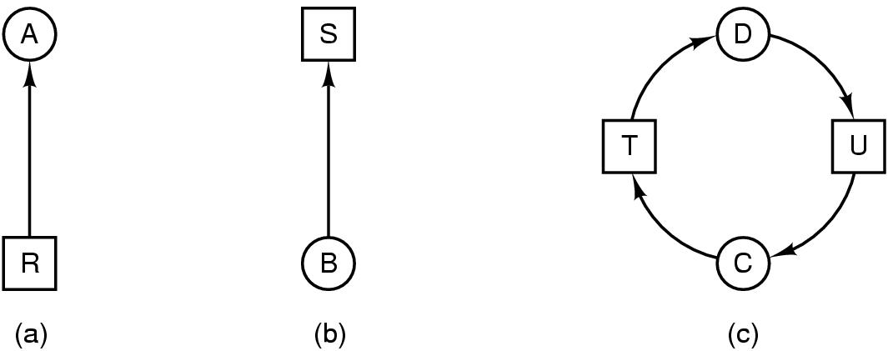
Deadlock Modeling
Modeled with directed graphs
  2 types of nodes: process , resource
  edges
    R ---> A ; resource R assigned to process A
    B ----> S ; process B is blocked or waiting for resource S
  process C and D are in deadlock over resources T and U

Slide 11
Deadlock Modeling
A cycle in the graph means that there is a deadlock involving the processes and resources in the cycle (assuming that there is one resource of each kind).
In this example, the cycle is C–T–D–U–C.

Slide 12
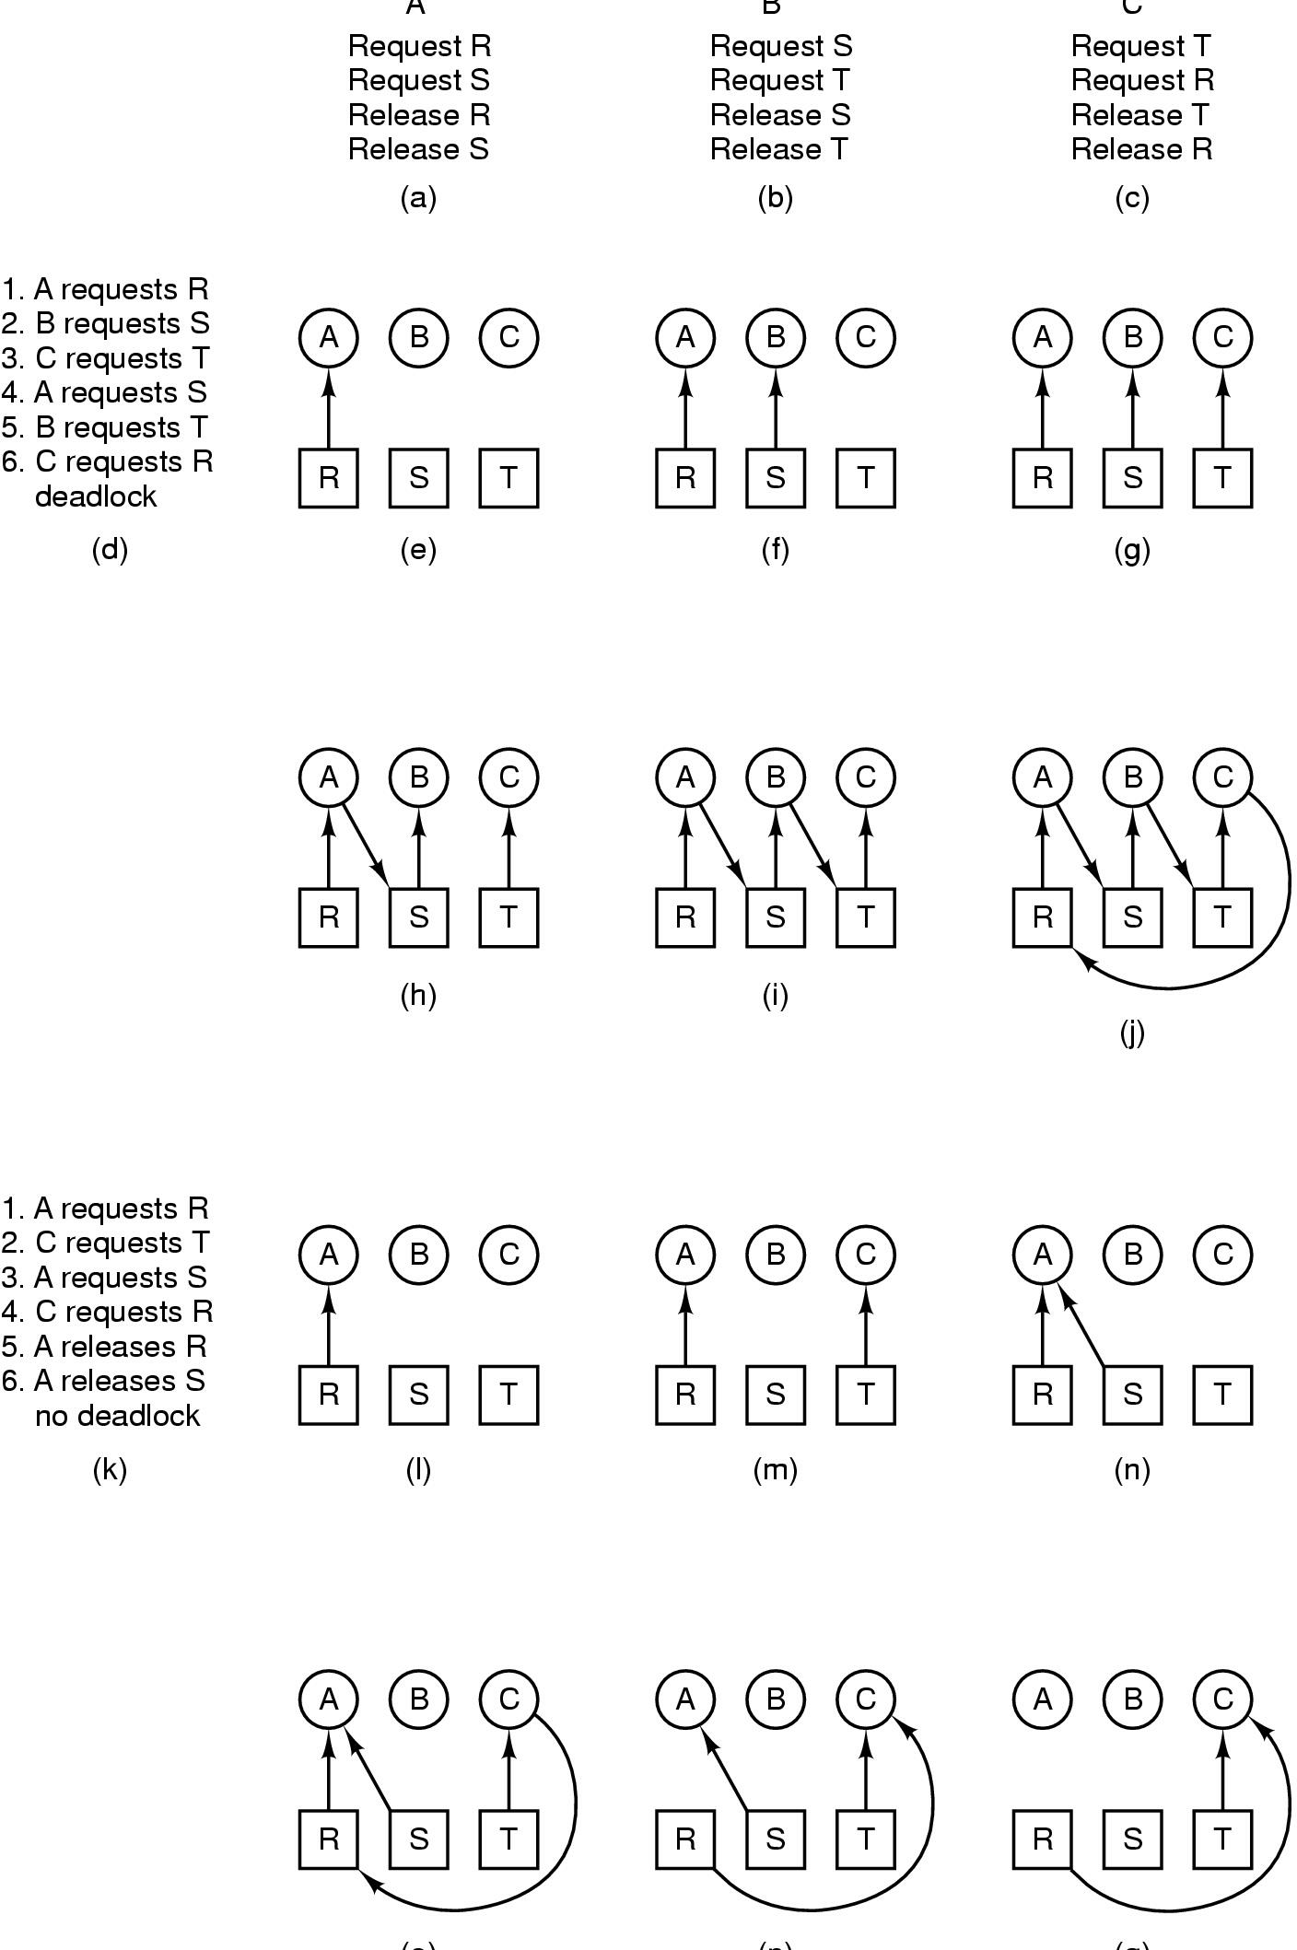
Deadlock Modeling
A B C
How deadlock occurs

Slide 13
Deadlock Modeling
(o) (p) (q)
How deadlock can be avoided

Slide 14
Deadlock Modeling
resource graphs are a tool for finding if a given request/release sequence leads to deadlock.
We just carry out the requests and releases step by step, and after every step check the graph to see if it contains any cycles.
Although we used resource graphs for the case of a single resource of each type,
resource graphs can also be generalized to handle multiple resources of the same type

Slide 15
Dealing with Deadlocks
Strategies for dealing with Deadlocks
  just ignore the problem altogether
  detection and recovery
    Let deadlocks occur, detect them, and take action.
  dynamic avoidance
    careful resource allocation
  prevention
    negating one of the four necessary conditions

Slide 16
1.The Ostrich Algorithm
The simplest approach
Don’t do anything, simply restart the system
Rational:
  Deadlock prevention, avoidance or detection/recovery algorithms are expensive
  if deadlock occurs only rarely, it is not worth the overhead to implement any of these algorithms.
UNIX and Windows takes this approach
It is a trade off between
  convenience
  correctness

Slide 17

2.1 Detection with One Resource of Each Type
Note the resource ownership and requests
A cycle can be found within the graph, denoting deadlock

Slide 18
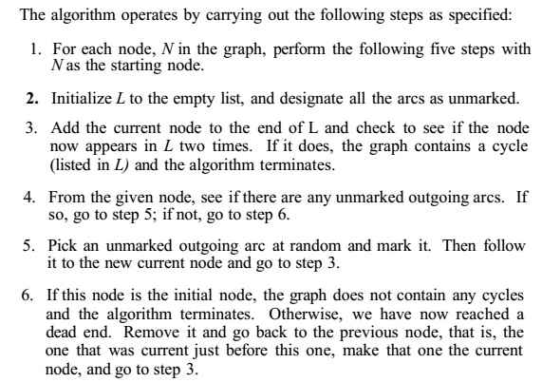

Detection with One Resource of Each Type

Slide 19
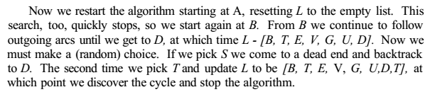
Detection with One Resource of Each Type

Slide 20
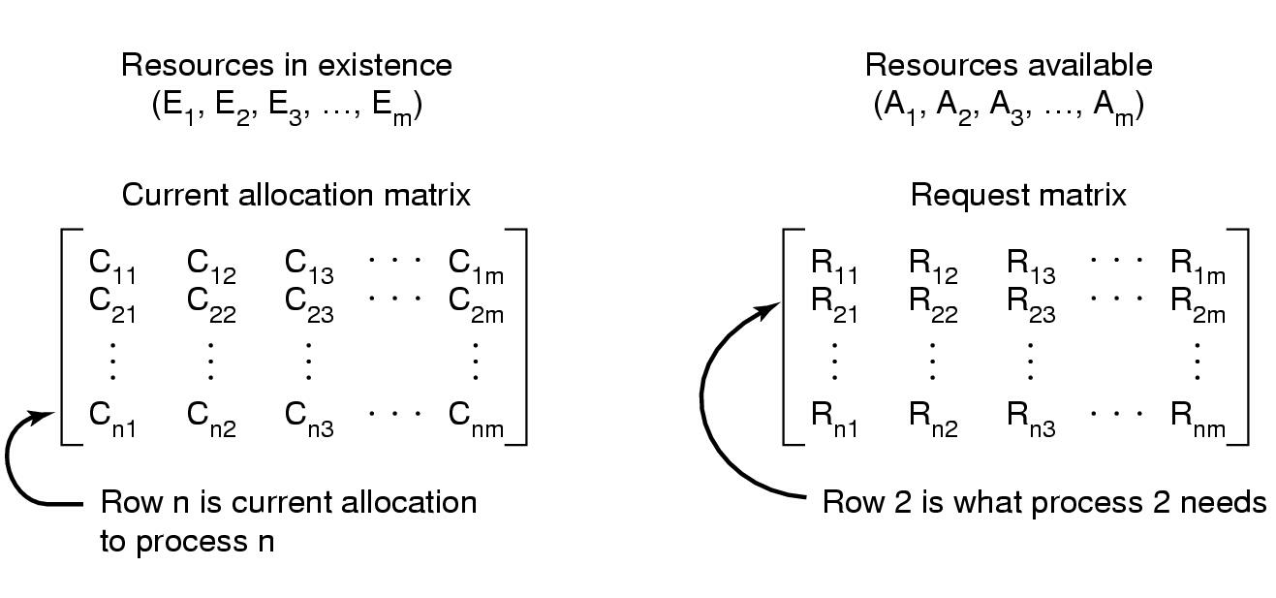
2.2 Detection with Multiple Resource of Each Type
Data structures needed by deadlock detection algorithm

Slide 21
Detection with Multiple Resource of Each Type
Invariant: ∑_{1≤i≤n}C_{ij} + A_{j} = E_{j}
Algorithm:
  Look for an unmarked process, P_{i}, for which the i-th row of R is less than or equal to A.
  If such a process is found, add the i-th row of C to A, mark the process, go to step 1.
  If no such process exists, terminate
After termination, all the unmarked processes are deadlocked.

Slide 22
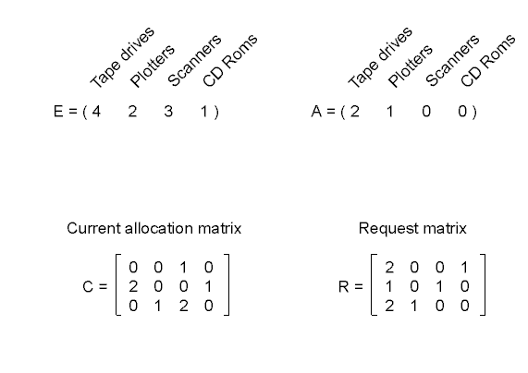
Detection with Multiple Resource of Each Type
An example for the deadlock detection algorithm

Slide 23
When to run Detection Algorithm?
Every time a resource request is made
  Can detect deadlock as early as possible
  Expensive in terms of CPU time
When CPU utilization drops below a threshold
  If enough processes are deadlocked there will be few runnable processes
Dept. of CSE, BUET
Notes:
Courtesy by: Cornell University and UIUC

Slide 24
2.3 Recovery from Deadlock
Recovery through preemption
  take a resource temporarily from the current owner process
  depends on nature of the resource
Recovery through rollback
  checkpoint a process periodically
  use this saved state
  Rollback a process to an earlier time if needed

Slide 25
Recovery from Deadlock
Recovery through killing processes
  crudest but simplest way to break a deadlock
  kill one of the processes in the deadlock cycle
  the other processes get its resources
  choose process that can be rerun from the beginning
  Alternatively, one of the processes not deadlocked may be killed!!!

Slide 26
3. Deadlock Avoidance
In most systems, resources are requested one at a time
To avoid deadlock the system must be able to decide whether granting a request is safe or not and only make the allocation when it is safe
But we need some information in advance

Slide 27
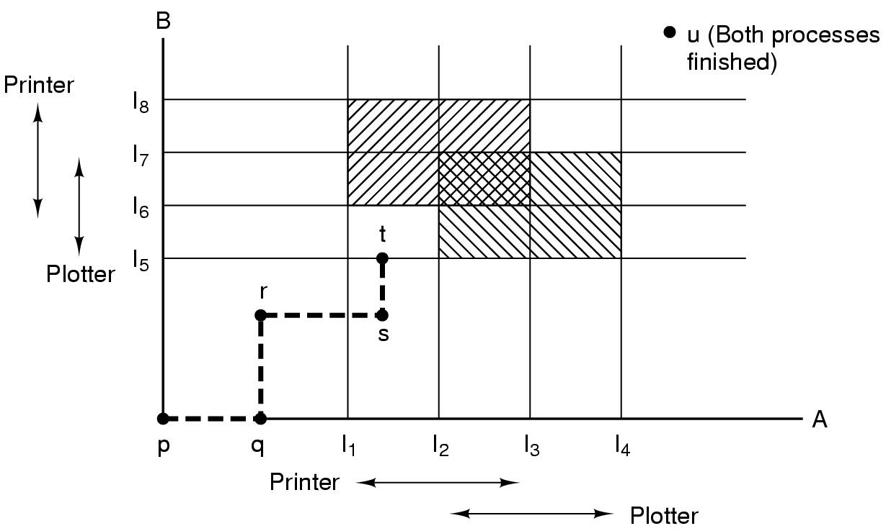
Concept of Safety
Two process resource trajectories

Slide 28
Safe and Unsafe States
A state is safe if
  there is some scheduling order in which
  every process can complete even if
  all of them suddenly request their maximum number of resources immediately

Slide 29
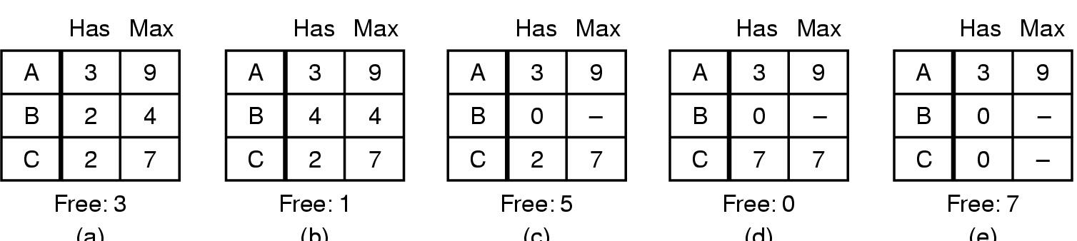
Safe and Unsafe States
One Resource Case
Total 10 instances available
(a) (b) (c) (d) (e)
Demonstration that the state in (a) is safe

Slide 30
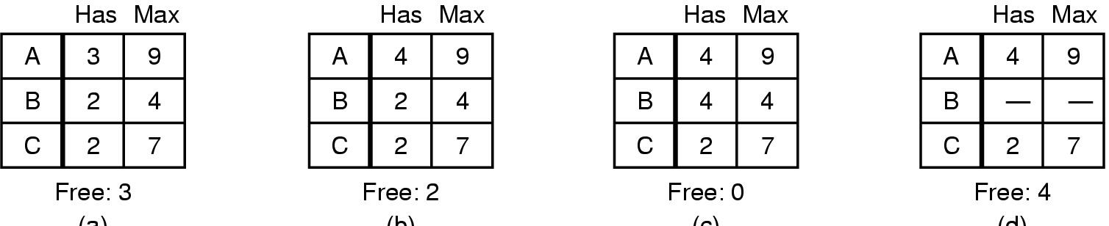
Safe and Unsafe States
(a) (b) (c) (d)
Demonstration that the sate in (b) is not safe
The allocation decision that moved the system from (a) to (b) went from a safe state to unsafe state
NOTE: An unsafe state is not a deadlocked state
Safe Vs Unsafe
  A safe state guarantees that all processes will finish

Slide 31
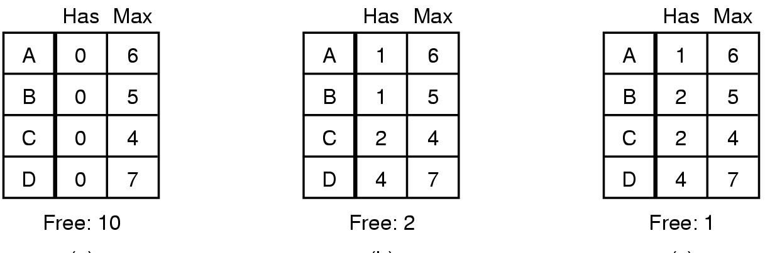
The Banker's Algorithm for a Single Resource
(a) (b) (c)
Three resource allocation states
  safe
  safe
  unsafe

Slide 32
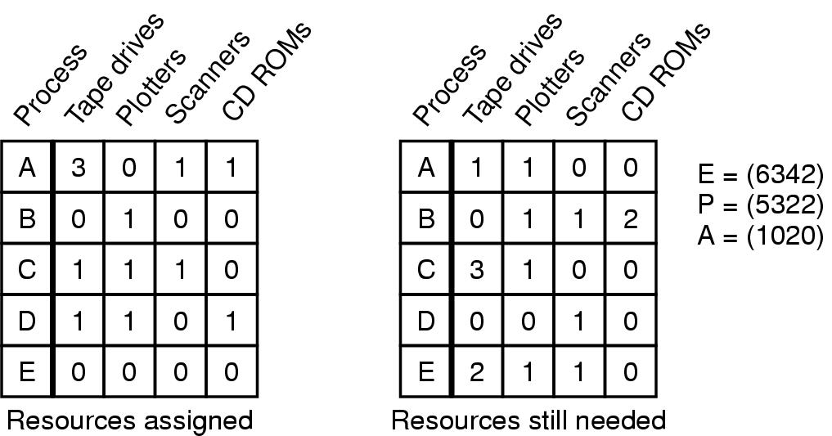
Banker's Algorithm for Multiple Resources
Example of banker's algorithm with multiple resources

Slide 33
Banker's Algorithm for Multiple Resources: Algorithmic Steps
Look for a row, R, whose unmet resource needs are all smaller than or equal to A. If none exists then DEADLOCK
Mark the process as terminated and add all its resources to A
Repeat steps 1 and 2 until either all processes are terminated in which case the initial state was safe, or until a deadlock occurs in which case it was not

Slide 34
Banker's Algorithm for Multiple Resources: Disadvantages
Theoretically wonderful but in practice essentially useless.
Why?
  Processes rarely know in advance what there maximum resource needs will be
  The number of processes is not fixed, but dynamically varying.
  Available resources may vanish (Broken tape drives)!!!

Slide 35
4. Deadlock Prevention
Ensure at least one of the 4 conditions is never satisfied
  Attacking the Mutual Exclusion Condition
  Attacking the Hold and Wait Condition
  Attacking the No Preemption Condition
  Attacking the Circular Wait Condition

